Slide 1
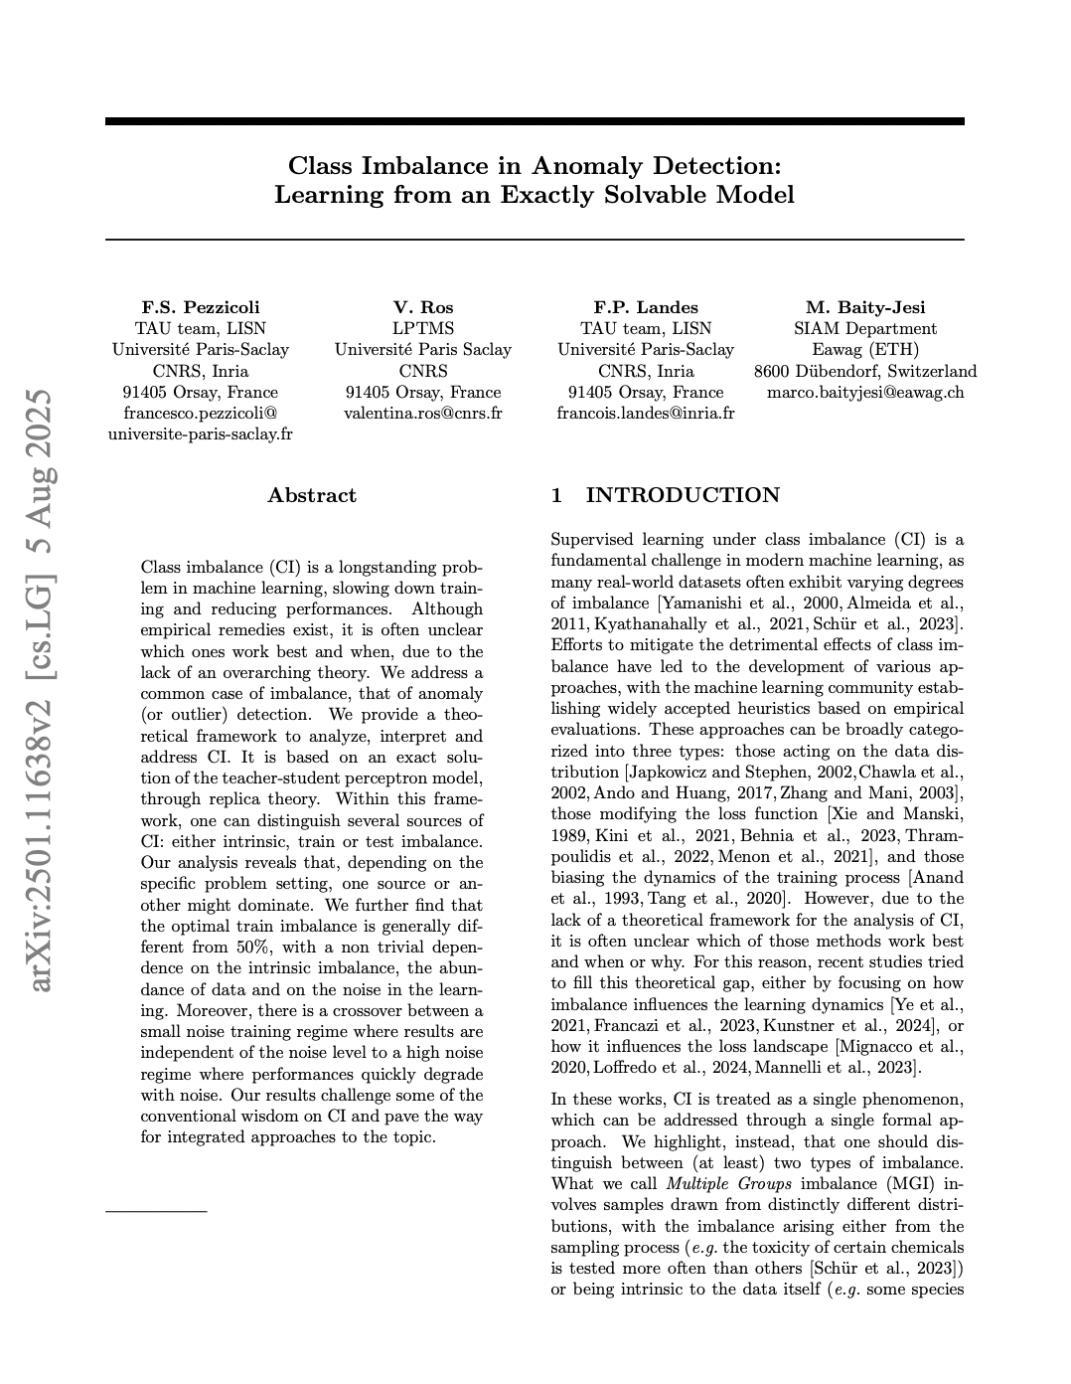
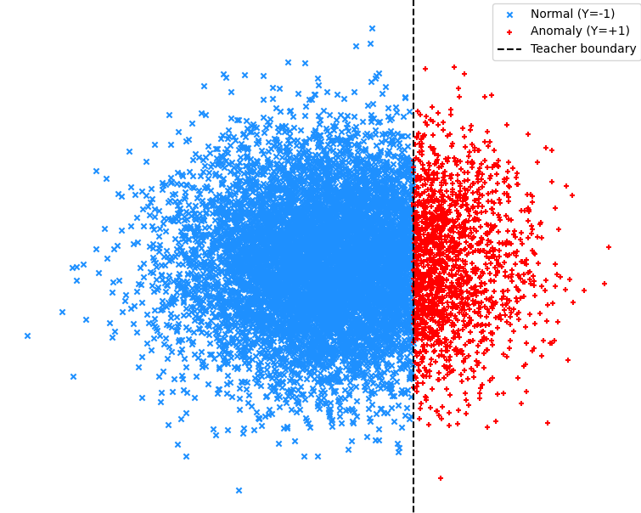
Revisiting Optimal Class Ratios in Imbalanced Learning
Pezzicoli, F.S., Ros, V., Landes, F.P., Baity-Jesi, M.: Class imbalance in anomaly detection: Learning from an exactly solvable model (2025), https://arxiv.org/abs/2501.11638
JDSE 2025, Baptiste PRAS

Slide 2
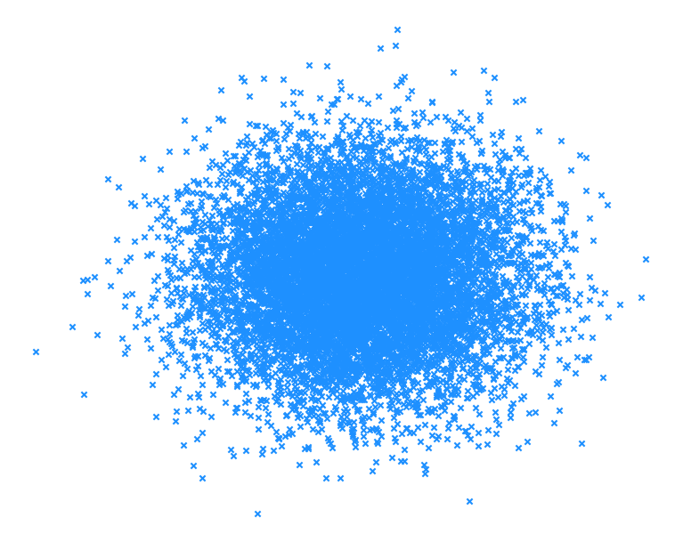
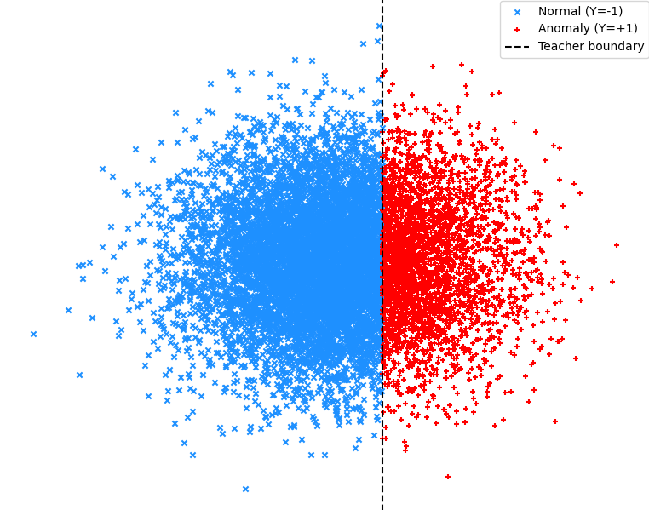
DATA
Gaussian data (unlabeled)
Gaussian data, labeled with teacher (bias = -0.5)
Gaussian data, labeled with teacher (bias = -1.0)
Revisiting Optimal Class Ratios in Imbalanced Learning, JDSE 2025

Slide 3
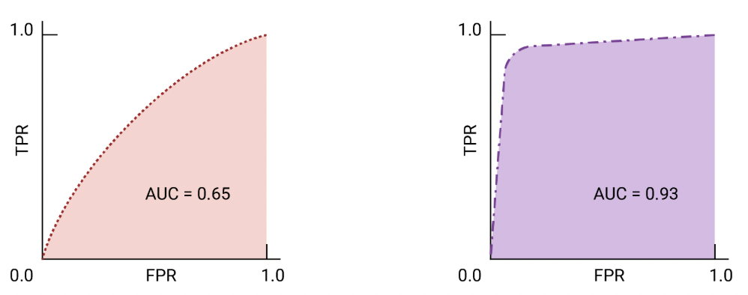





Methods
Borysenko, O., Byshkin, M.: Coolmomentum: A method for stochastic optimization by langevin dynamics with simulated annealing. Scientific Reports 11(1), 10705 (2021)
Revisiting Optimal Class Ratios in Imbalanced Learning, JDSE 2025

Slide 4
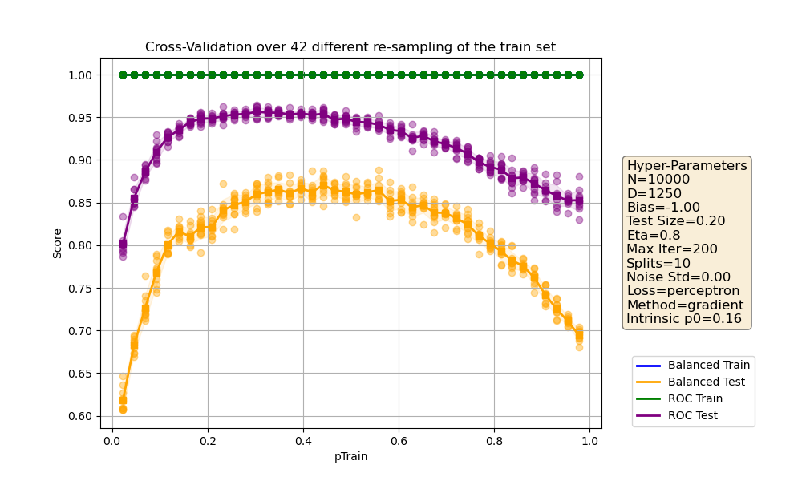
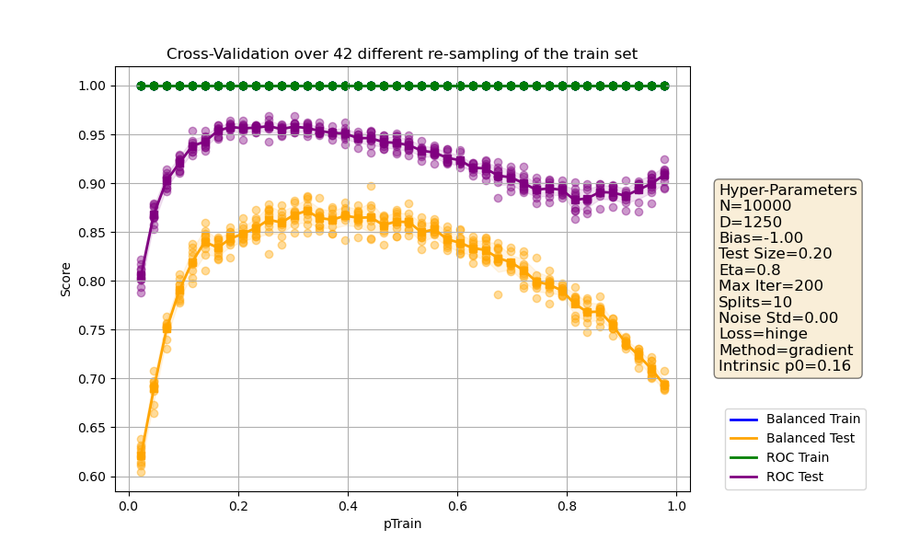
RESULTS
Gradient Descent using the Perceptron loss
Gradient Descent using the Hinge loss
Revisiting Optimal Class Ratios in Imbalanced Learning, JDSE 2025

Slide 5
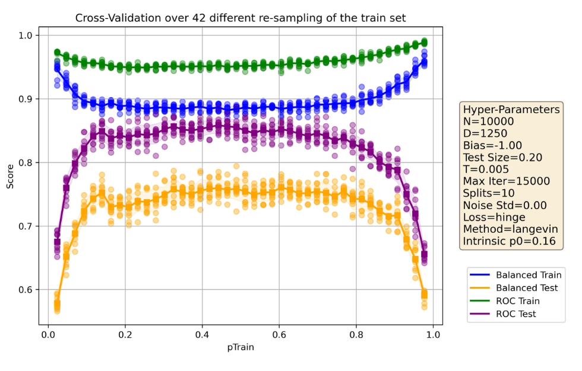
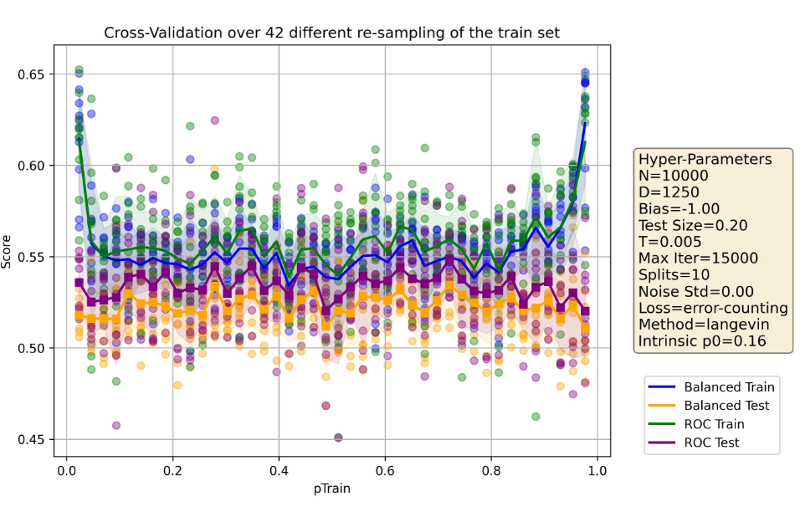
RESULTS
Langevin Dynamics using the Hinge loss
Langevin Dynamics using the Error-Counting loss
Revisiting Optimal Class Ratios in Imbalanced Learning, JDSE 2025

Slide 6
Conclusion
OPTIMAL IMBALANCE RATIO IN THE TRAIN SET:
0.5
TUNABLE
HYPERPARAMETER
Revisiting Optimal Class Ratios in Imbalanced Learning, JDSE 2025

Slide 7
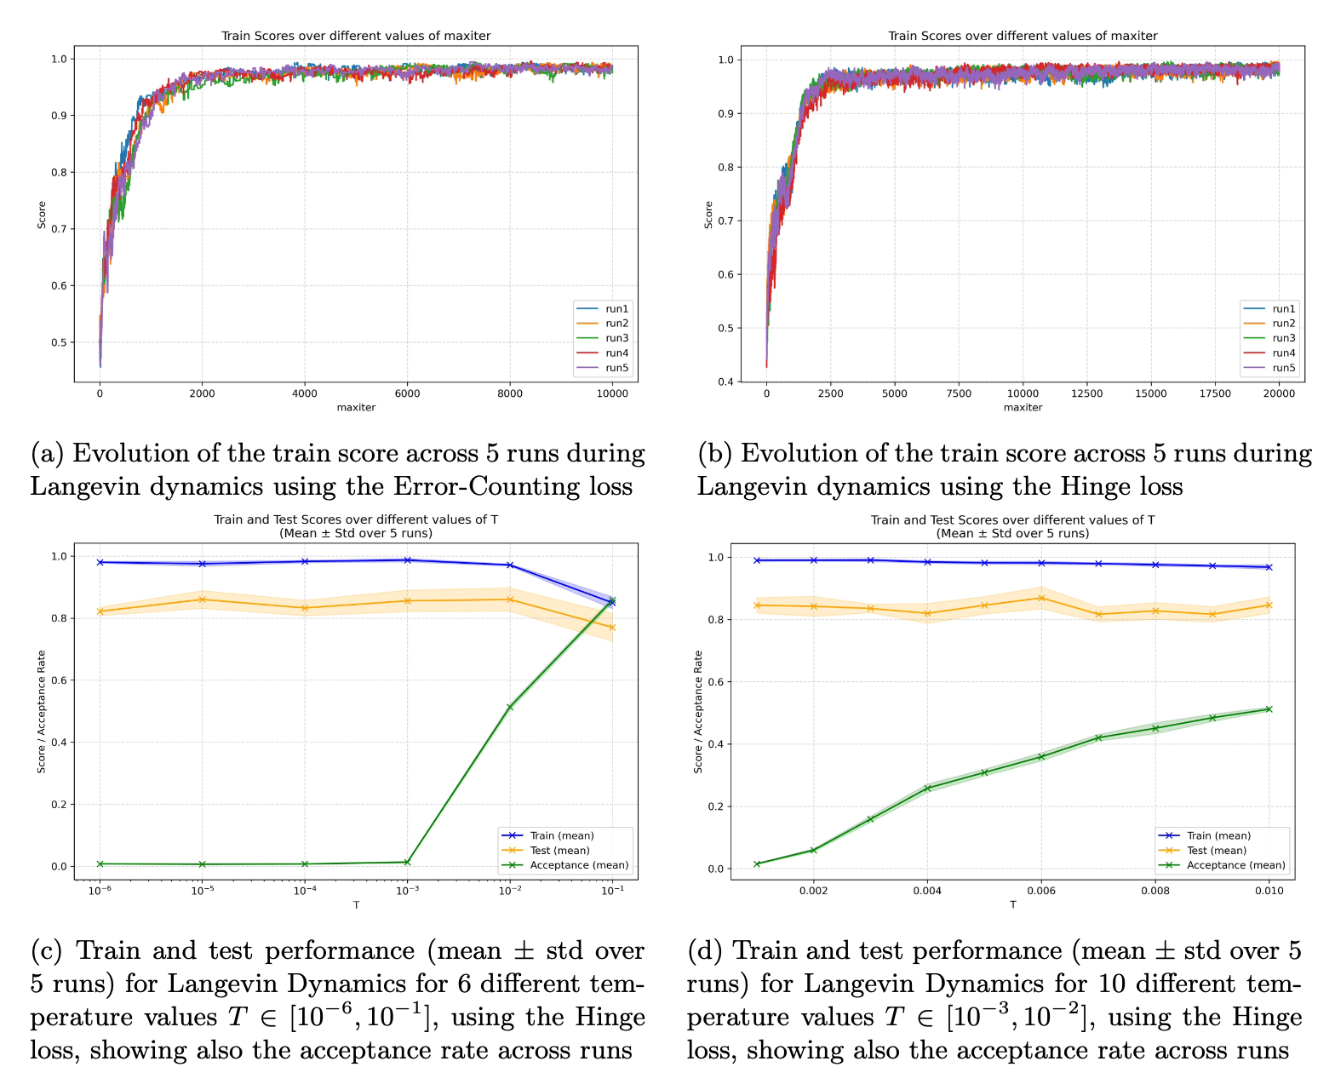

ADDITIONAL INFOS
Hyperparameters
GD
Langevin
maxiter
200
15,000
Learning rate
0.8
/
T
/
*
0.05 -> 0.005
*0.05 for the first 1,500 iterations, 0.005 then
exp(- $\frac{ΔE}{T}$)
Revisiting Optimal Class Ratios in Imbalanced Learning, JDSE 2025

